Slide 1
GPGPU Computing with OpenCL
Bernhard Manfred Gruber
Notes:
Welcome to my presentation about GPGPU Computing with OpenCL.
The presentation will be in English as this is also the language I have chosen for my bachelor thesis.

Slide 2
Overview
Hardware
OpenCL
Concepts
Problems & implementations
Benchmarks
Conclusion
Notes:
At the beginning we will have a short look on the main differences between typical CPU and GPU hardware.
Afterwards, OpenCL is introduced as a programming framework along with several concepts, which make OpenCL different from traditional software developing. This theoretical introduction forms the first part of the presentation.
The second part will give an overview of the chosen problems and implemented algortihms to solve them. Each algorithm has been benchmarked and compared with other algorithms of the same problem.
Finally and based on the provided benchmark charts, we will be able to conclude which types of problems benefit from being run on the GPU and which do not.

Slide 3
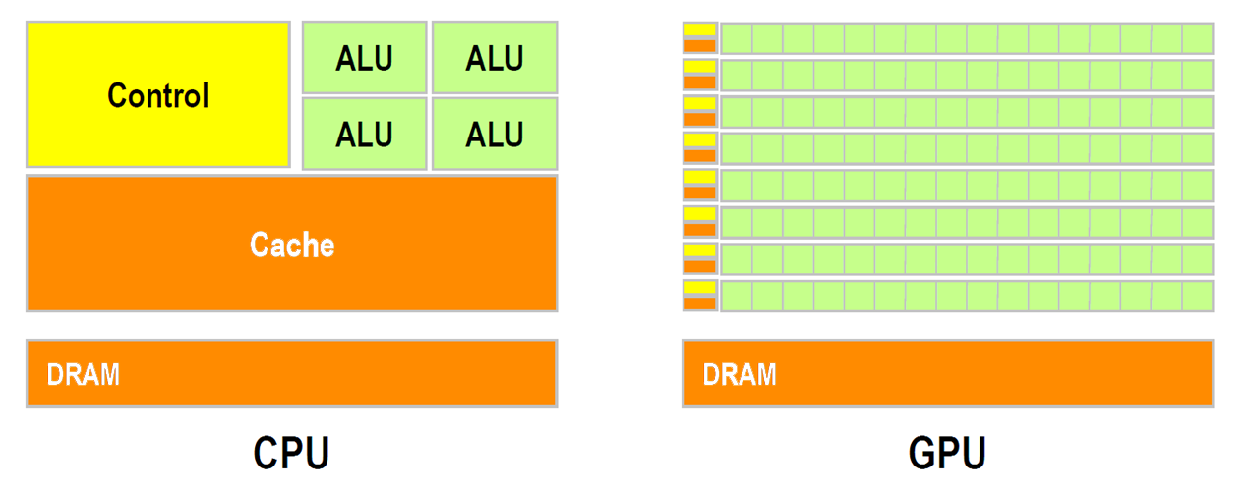
Hardware
http://gpgpu.org/static/sc2007/SC07_CUDA_1_Introduction_Luebke.pdf/
Notes:
A typical CPU has around 4 independent cores. We can run threads on them and we can do all that stuff with synchronization like locks, critical seconds and so on.
On a GPU we have several hundreds of cores which run basically independent.

Slide 4

GPU Hardware
OpenCL Driver
OpenCL API
OpenCL C Compiler
Host Application
OpenCL Kernels
CPU Hardware
Open Computing Language
Notes:
OpenCL is a free and open standard maintained by the Khronos Group. It is used as a framework for writing programs, called kernels, for various kinds of processing devices. Most importantly, the GPU.
Kernels are sparated from the application using OpenCL, which is called the host application. To achieve portability accross hardware, kernels are compiled at run time for a specific device using the OpenCL C Compiler. However, the resulting program cannot be run on its own, ineeds a so called host application, which moves this OpenCL program through the driver to the GPU. The host application running on the CPU then communicates with the OpenCL kernel through the OpenCL API and driver.

Slide 5
Platform model

Slide 6
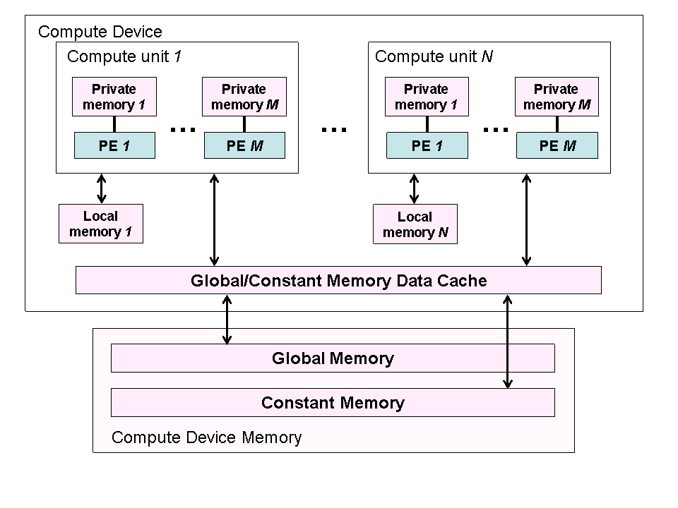
Memory model
http://www.khronos.org/registry/cl/specs/opencl-1.2.pdf

Slide 7
Execution model
ND
R
ange
a
w
o
r
k
g
r
oup
WG
WG
WI
WI
0,0
Gx,0
0,0
Lx,0
G
S
y
L
S
y
WG
WG
WI
WI
0,Gy
Gx,Gy
0,
L
y
Lx,
L
y
GSx
LSx

Slide 8
Algorithms
Prefix Sum
Sorting
Matrix Mult
Notes:
The algorithms I have chosen for my thesis are … which I will discuss on the following slides.

Slide 9
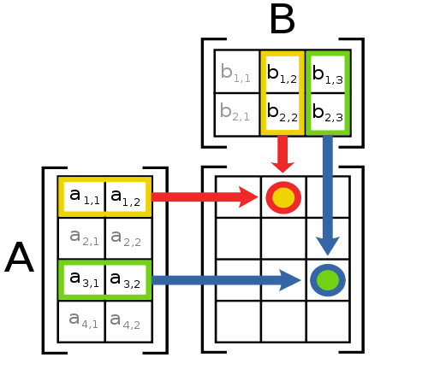
Matrix Mult
n³
http://en.wikipedia.org/wiki/File:Matrix_multiplication_diagram_2.svg
Notes:
The first problem I tried was the matrix multiplication. The beauty of this problem is that each output element is computed completely independently of each other element. This means, that calculating the result matrix should be very fast and easy to implement on a GPU, as we can simply assign each separate output element to a different work item.

Slide 10
Benchmark

Slide 11
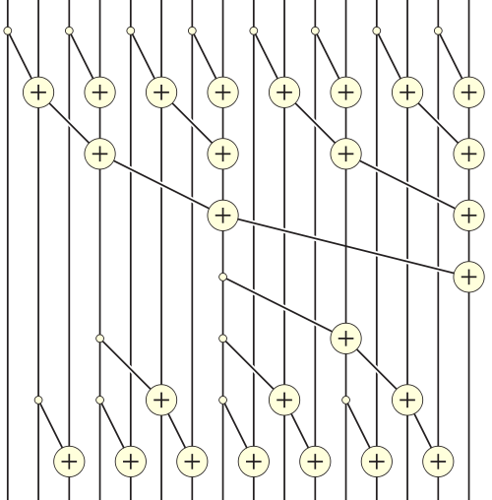
16 Elements
Prefix Sum
5 | 1 | 3 | 4 | 2 | 8 | 0 | 4 | 7 | 7 | 4 | 3 | 0 | 3 | 9 | 4
n log n
7 Passes
26 Additions
5 | 6 | 9 | 13 | 15 | 23 | 23 | 27 | 34 | 41 | 45 | 48 | 48 | 51 | 60 | 64
http://en.wikipedia.org/wiki/Prefix_sum
Notes:
The prefix sum, also called scan, is a very simple operation running in linear time on a CPU.
The scan takes an input array and sums up all preceding elements and the value itself for each element in the input.
This is very simple on a CPU, but harder to parallelize than for example the matrix multiplication. A possible solution is to use a tree shaped reduce and scatter approach. This results in several passes. Additions inside a pass may be executed in parallel. However, the cost of the gained parallelism is payed by an increase in additions.
Let's look how this turns out.

Slide 12
Benchmark

Slide 13
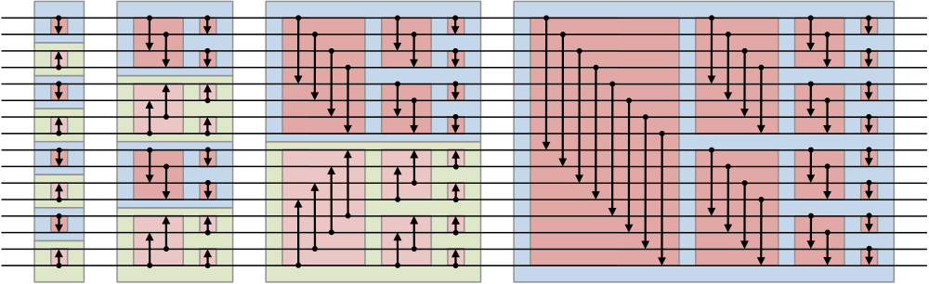
Sort
n log² n
Bitonic Sorting Network
16 Elements
10 Passes
http://en.wikipedia.org/wiki/Bitonic_sorter
Notes:
An often used solution for parallel sorting are sorting networks. The bitonic sorter is one of these networks. A sorting network consists of wires, where the values travel along, and comperators which compare and swap them.
So we basically attach an input array to the left side and let it travel through the network. The output is a sorted array at the right side.
The parallelization of the bitonic sorter is also bought on behalf of runtime complexity.
What are the results?

Slide 14
Benchmark

Slide 15
Conclusion
GPUs awesome, IF problem:
Highly parallelizable
Small, independent pieces
Arithmetically intensive
Small memory transfers
Notes:
The conclusion that we can draw from these results is that GPUs are awesome!
IF, the problem is …
Otherwise it is the better idea to develop for a CPU, as this is usually much easier.
Thank you for listening.

Slide 17
Extra slides

Slide 18
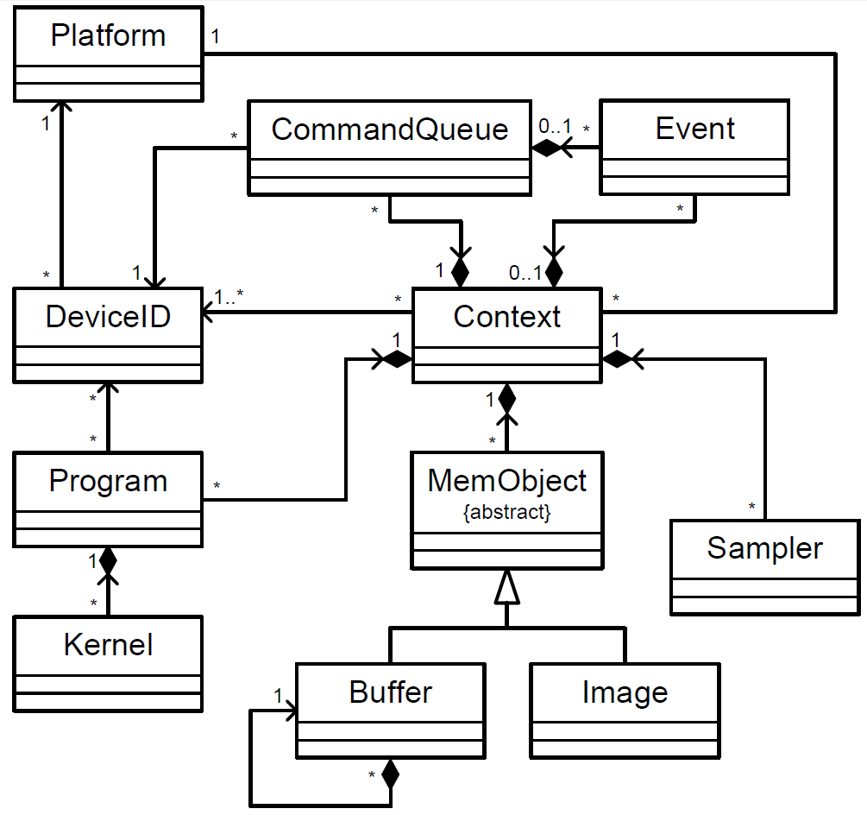

Slide 19
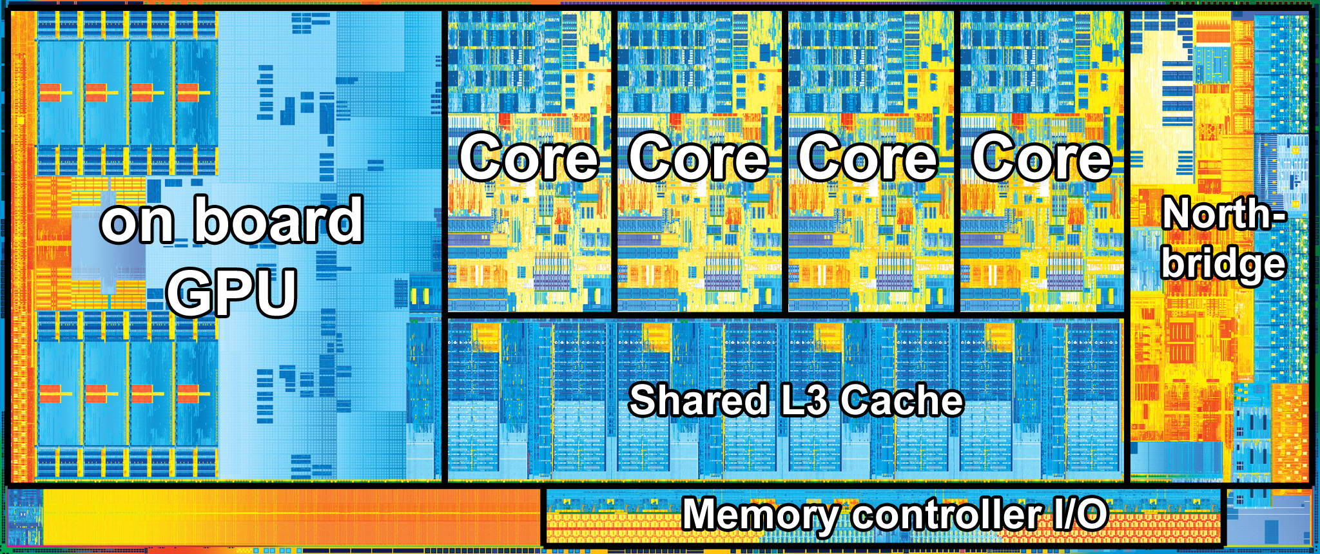

Slide 20
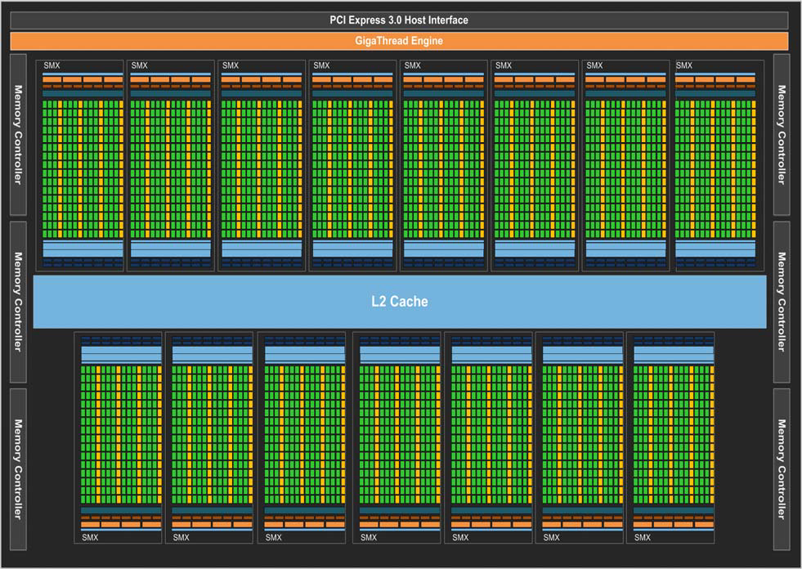

Slide 21
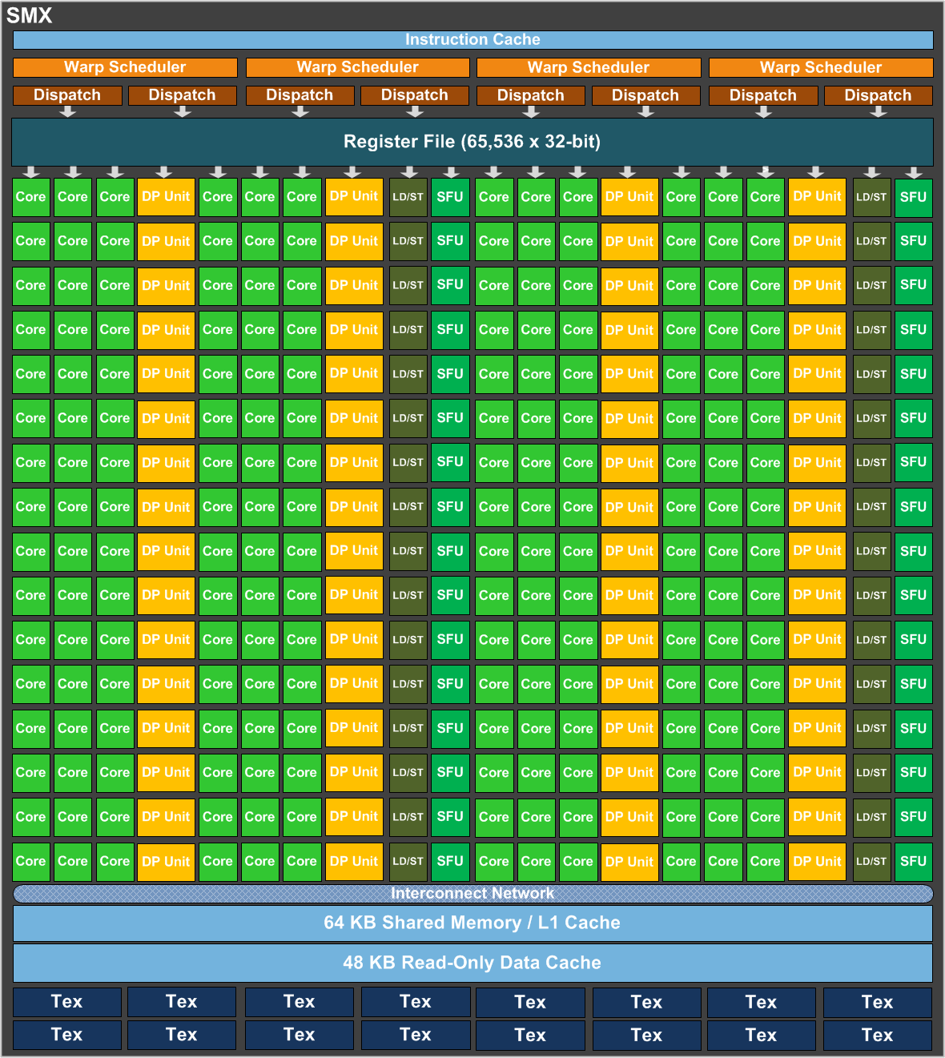

Slide 22
